Slide 1


Saveetha school of engineering
ONLINE GROCERY PRODUCTS OF BIG BASKET
Project By: A.Indrasena Reddy
Reg NO: 191911040
Dept: CSE
Sub: Software Testing for Android Applications
Sub code: CSA3731
Date: 31/01/2023

Slide 2
OBJECTIVES
Job Objective Seek a Grocery Store Clerk position where I can apply my experience and efficiently contribute to the company's growth.
The primary objective of supermarket layout is to ensure a smooth flow of material, other information etc., within a supermarket.

Slide 3
Abstract
The business-to- consumer aspect of an online shopping is the most visible business use of the World Wide Web. The primary goal of an online shopping site is to sell goods and services online. This project deals with developing an e- commerce website for online shopping. It provides the user with a catalogue of different goods and services available for purchase in the store. In order to facilitate online purchase a shopping cart is provided to the user. The system is implemented using a 3- tier approach, with a backend database, a middle tier of Microsoft Internet Information Services (MIIS) and PHP, and a web browser as the front end client. In order to develop an e- commerce website for online shopping, a number of Technologies must be studied and understood. These include multi-tiered architecture, server and client side scripting techniques, implementation technologies such as ASP

Slide 4
Proposed system
To workshop while in the luxury of your own home, without having to period out of the door.
Sell at lesser rate due to a lesser amount of overhead.
Provide home delivery free of cost.
Display all the available categories for shopping on the home page.
Display all the subcategories on the home page, that are associated with any particular item.
Admin has the authority to add new particulars to the items list whenever needed.
Permission to the administrator to remove items, anytime.
Allows the admin to modify the price of each item, whenever required or felt like.
Admin has the authority to update the description of each item.
Permission to the admin to view information about each customer who checkouts the items list.

Slide 5
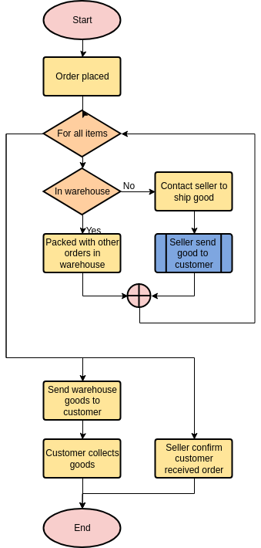
FLOWCHART

Slide 6
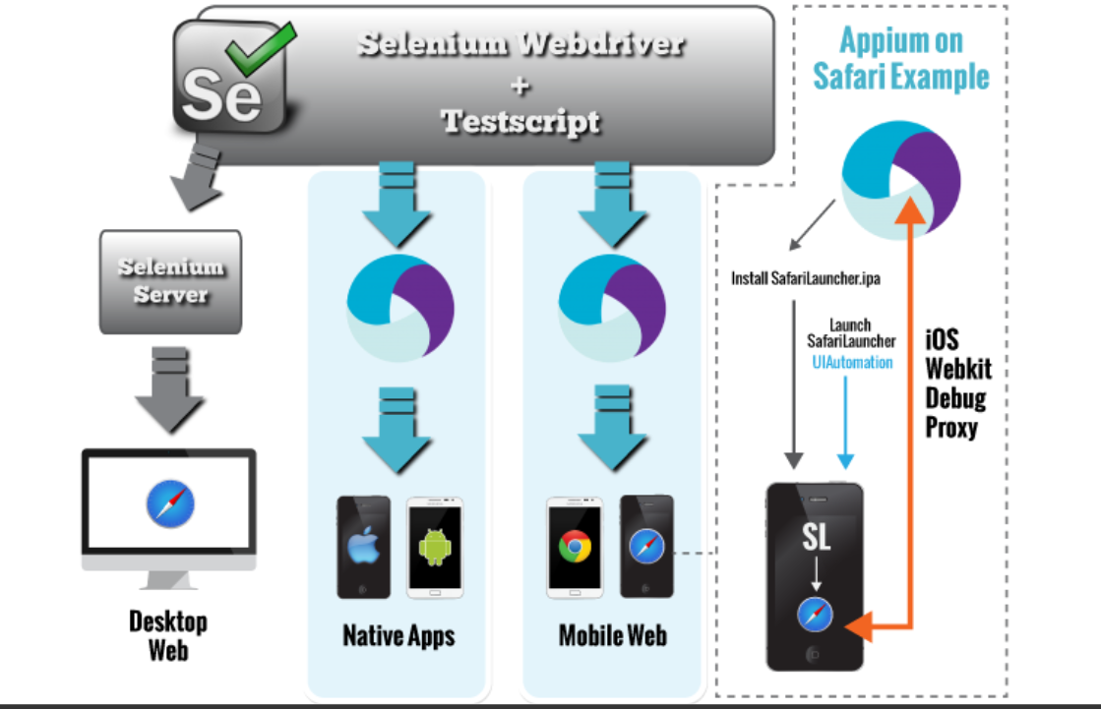
CONCEPT MAP
A data model is a conceptual representation of the data structures that are required by a database. The first step in designing a database is to develop an Entity- Relation Diagram (ERD). The ERD serves as a blue print from which a relational database maybe deduced. Figure 1 shows the ERD for the project and later we will show the transformation from ERD to the Relational model.

Slide 7
TEST CASES
Below are some basic test scenarios related to the shopping cart and checkout pipeline which needs to be covered before release.
Shopping Cart:-
Add one item to the cart and verify.
Increase the quantity of the item from the cart and verify.
Add the same item multiple times and verify.
Add multiple items of different types and verify.
Remove some items from the cart and verify.
Remove all items from the cart and then verify.
Click on an item in the cart and verify that the user is redirected to the product detail page.
Check that the price of the cart is discounted when we apply a valid coupon.
Check that the price of the cart is not discounted when we apply an invalid coupon.

Slide 8


APP TOOLS AND INSTALLATION

Slide 9


Slide 10
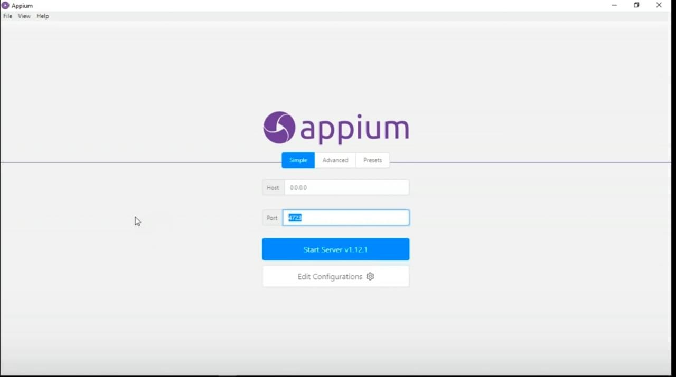

Slide 11
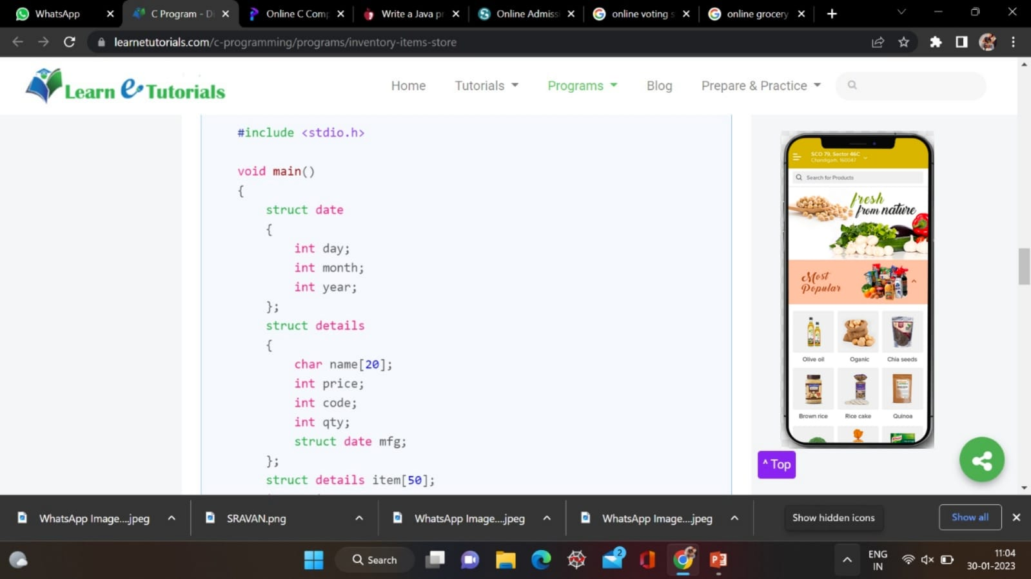
implementation

Slide 12
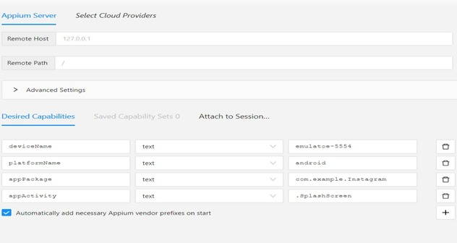

Slide 13
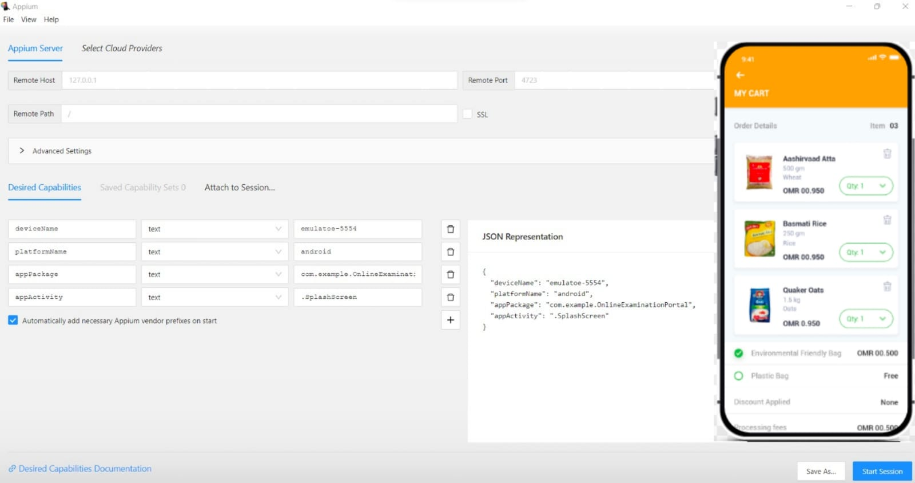

Slide 14
TEST CASE OUTCOMES
Test cases | Outcome
A user clicks on the Register button – a registration form opens | Positive
The account with the given username is not registered in the system – can’t log in | Negative
A user enters registration details in the correct format – registration is successful | Positive
A user is not logged in – only features and areas for non-logged users are available | Negative
A user enters the correct credentials – they log into the account | Positive
A user signs in with an old password entered after password change – can’t log in | Negative
Explore New Places, Try Food from Different Restaurants | Positive
Juggling With Your Health | Negative
Urban Restaurants, Reach Out to Remote Foodies | Positive
Disguised Increased Expense | Negative

Slide 15
Conclusion
The Internet has become a major resource in modern business, thus electronic shopping has gained significance not only from the entrepreneur’s but also from the customer’s point of view.
For the entrepreneur, electronic shopping generates new business opportunities and for the customer, it makes comparative shopping possible. As per a survey, most consumers of online stores are impulsive and usually make a decision to stay on a site within the first few seconds.
“Website design is like a shop interior. If the shop looks poor or like hundreds of other shops the customer is most likely to skip to the other site”[16]. Hence we have designed the project to provide the user with easy navigation, retrieval of data and necessary feedback as much as possible.

Slide 16
THANK YOU

